Slide 1


Agriculture & Agri-Food Canada Phage Genomics Workshop
Andrew M. Kropinski
Department of Pathobiology
University of Guelph, Canada
Email: Phage.Canada@gmail.com
Notes:
http://tbilisee.com/en/places/in/49-Education

Slide 2

Acknowledgement
We thank Brian Anderson from DNASTAR Inc. for access to the latest version of Lasergene Suite software

Slide 3
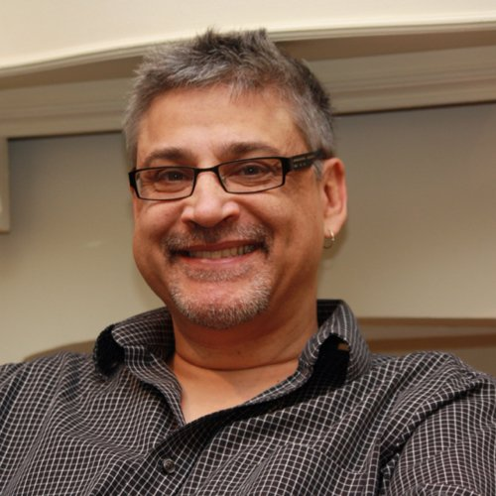
Biography
Been working on phages since mid-1960s
Held academic and government research positions
Currently advise students & faculty at the University of Guelph – Adjunct Professor
Past Chair, Bacterial and Archaeal Viruses Subcommittee of ICTV
Genome Advisor to NCBI
Sequenced: >150 phages
Default-setting bioanalyst - Online Analysis Tools (http://molbiol-tools.ca)
Apologies: I am a Windows and Mac person not a Unix/Linux user
If you're not a programmer...You're not a Bioinformatician! John H.E. Nash (PHAC)

Slide 4
Overview
You can:
have a commercial company sequence your phage, and assemble its genome
submit this sequence to GenBank and receive an “Accession Number”
annotate its genome using an online pipeline which will find that most of the genes specify “hypothetical proteins”
OR
4. Devote some time to (a) preparing your genome for annotation and (b) carefully scrutinizing the annotations i.e. follow what you learn in this workshop

Slide 5
Overview 2
Laboratory output:
High numbers of bacterial and phage genomes
Low number of bacterial and phage genomes
Bioinformatician
Computing resources
Python programs
Windows, Mac and internet resources as described in this workshop

Slide 6
Workshop Outline
Phage genome assembly – emphasis on Illumina paired-end data
Autoannotation coupled with manual proofreading
Phage taxonomy

Slide 7
Objectives
By the end of this workshop participants will
have a deeper understanding of the steps involved in sequencing, assembling, and annotating phage genomes
understand how phages are classified
have an authoritative list of Internet resources and recommended software (commercial and free) for genome analysis.

Slide 8
Genome Assembly
PART 1
Notes:
http://tbilisee.com/en/places/in/49-Education

Slide 9
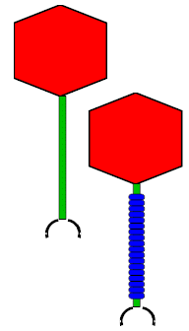




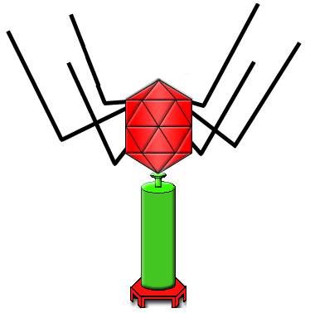


What We Want
Mixture
Frameshift
The goal:
complete
accurate
Incomplete
Faulty assembly
chimeric phages
Faulty assembly

Slide 10
Outline
Paired-end Illumina sequence data
Assemble
DNASTAR SeqMan NGen18
Primary assembly - contigs
Trim
DNASTAR SeqMan Ultra
Reassemble
Reassembly
Manipulation – RC, Cut/Paste, Splinting
SeqBuilder Pro
Genome for Annotation
Notes:
Short reads to contigs to complete genome to genome ready for annotation

Slide 11
Why emphasis on DNASTAR?
Developed by geneticist Fred Blattner and computing science student John Schroeder (1984)
I have been using their software since 1995
Company responds readily to enquiries
Software packages are really updated annually
Available for Mac and PCs
Intuitive software
Excellent tutorials/videos

Slide 12
Non-commercial Alternatives
SPAdes Genome Assembler
N.B. I do not recommend Nanopore for phage sequencing
works with Ion Torrent, PacBio, Oxford Nanopore, and Illumina paired-end
Linux, macOS
URL: https://github.com/ablab/spades
Reference: Prjibelski A, Antipov D, Meleshko D, Lapidus A, Korobeynikov A. Using SPAdes De Novo Assembler. Curr Protoc Bioinformatics. 2020 Jun;70(1): e102. doi: 10.1002/cpbi.102. PMID: 32559359.

Slide 13
Setup for sequence assembly & analysis
Create a directory with the name of the phage under analysis
Create four subdirectories:
Data
Assembly
Reassembly
Annotation

Slide 14
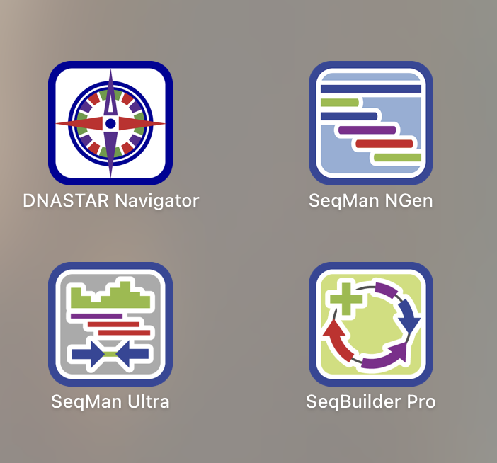
Genome assembly using SeqMan NGen18
Step-by-Step
START POINT - GENERAL
START POINT - SPECIFIC
Notes:
DATA: https://trace.ncbi.nlm.nih.gov/Traces/?view=study&acc=SRP159164

Slide 15
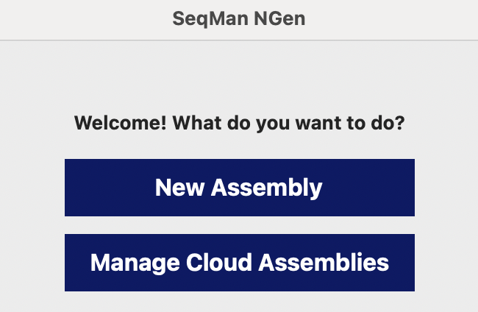
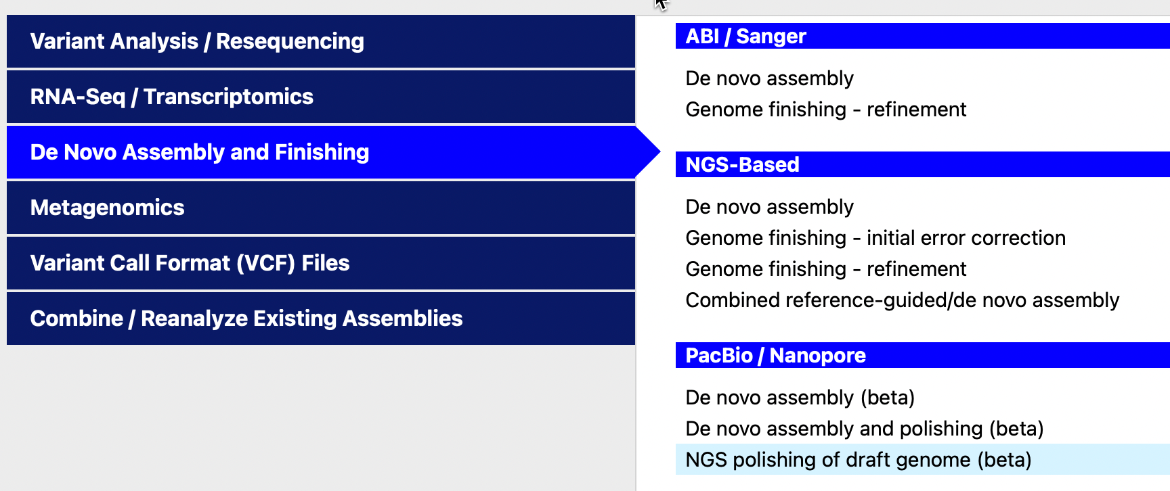
Move from screen to screen
with NEXT

Slide 16
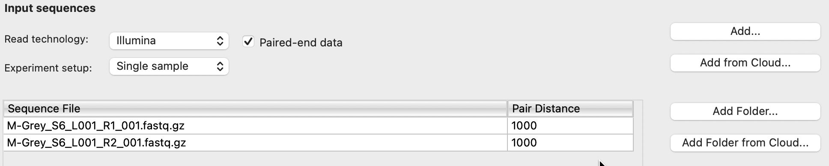
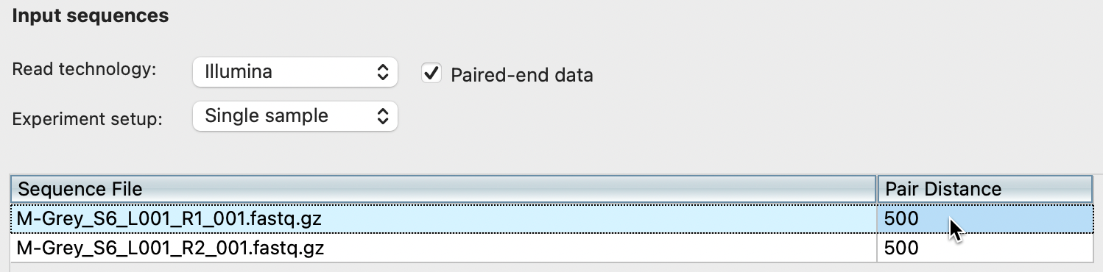
Adding Illumina data
N.B. Compressed fastq data

Slide 17
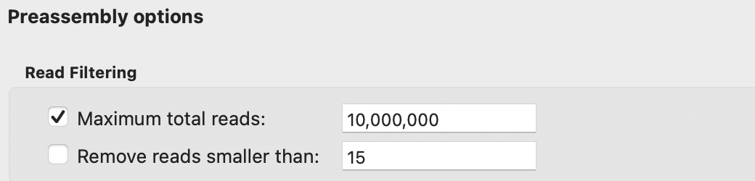
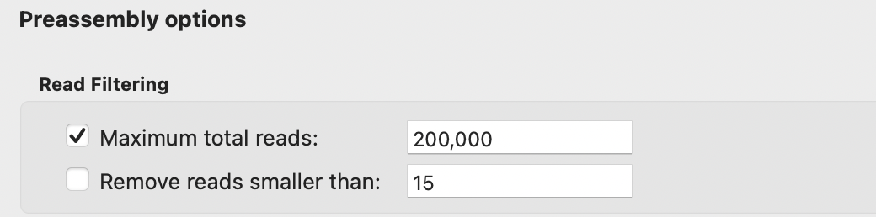
Changing number of reads
DEFAULT
DESIRED

Slide 18
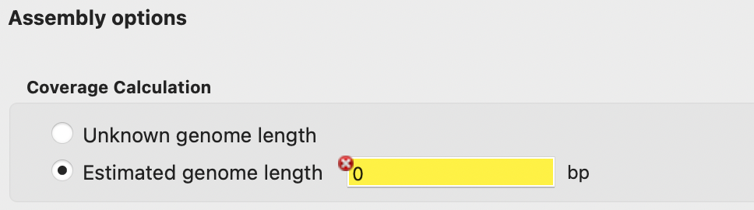
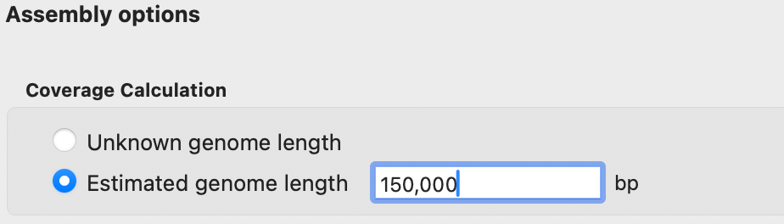
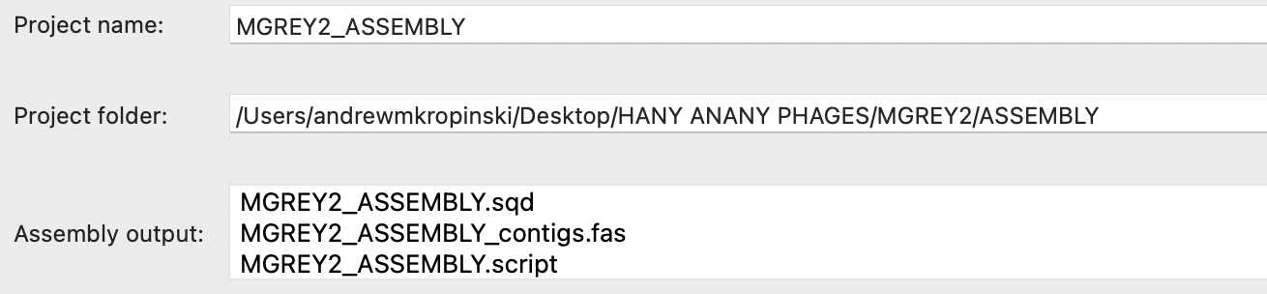
Assembly options and names
QUERRY
ANSWER

Slide 19
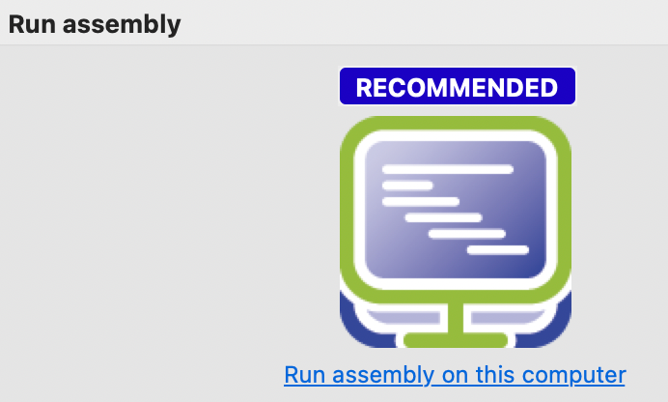
Run

Slide 20
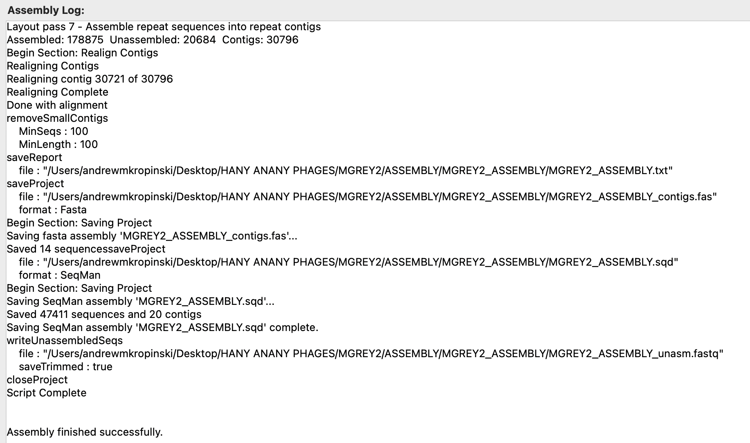
Finished

Slide 21
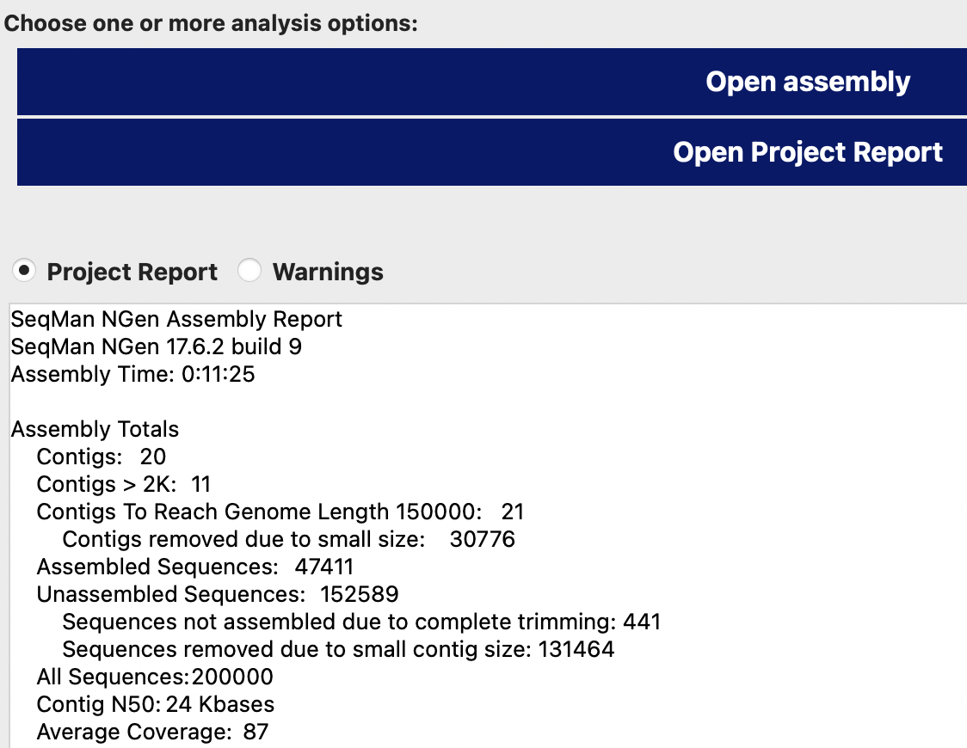

Useful data

Slide 22
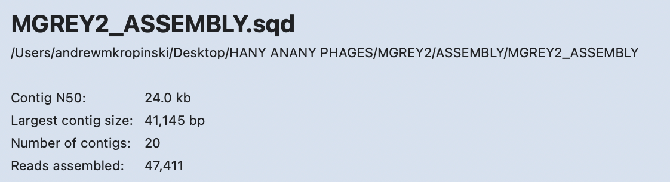
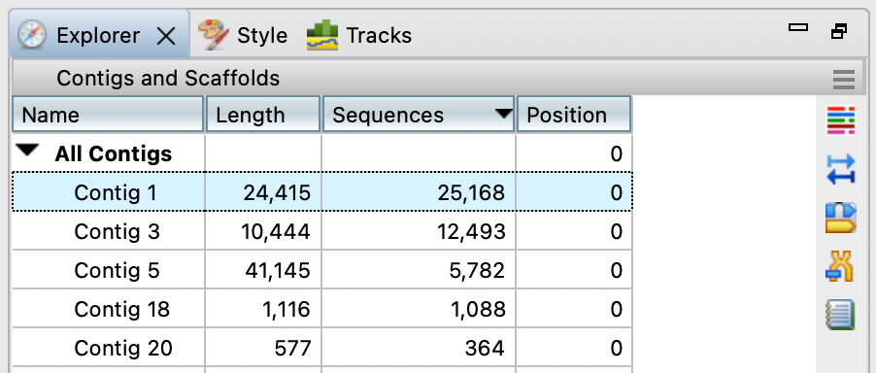
Examining & editing data in SeqMan Ultra
Click here to order by number of sequences
Click here to see a specific contig

Slide 23
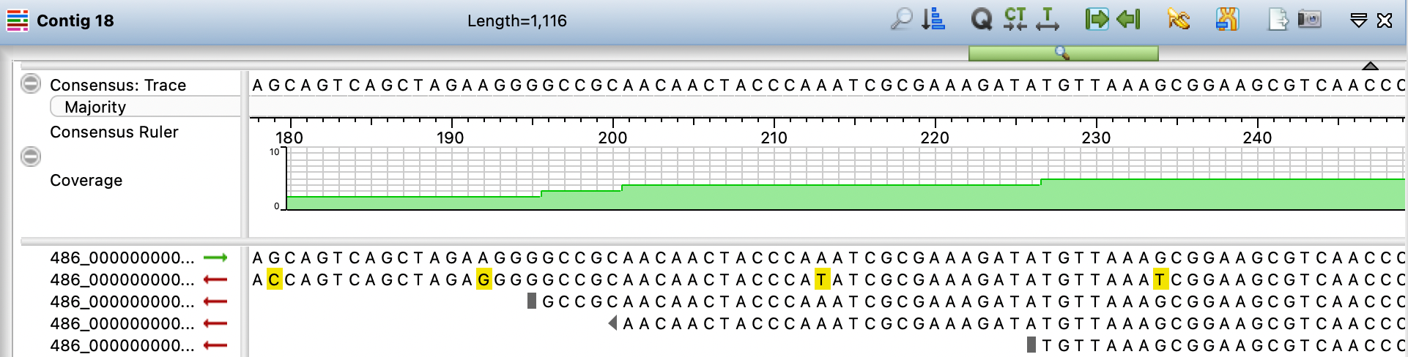
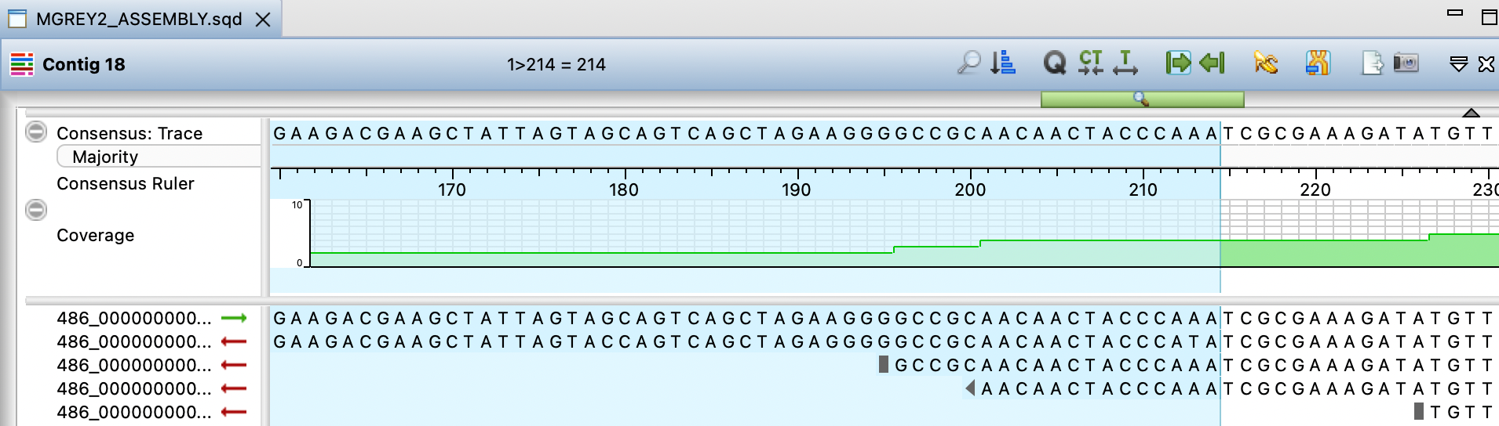
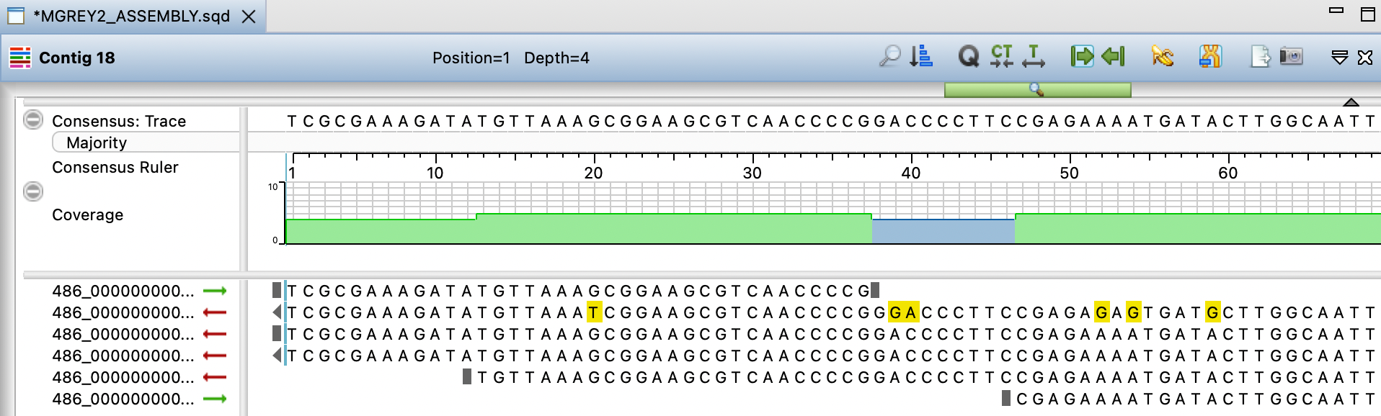
End trimming
Lock right
Save project as *_TRIM.sqd

Slide 24
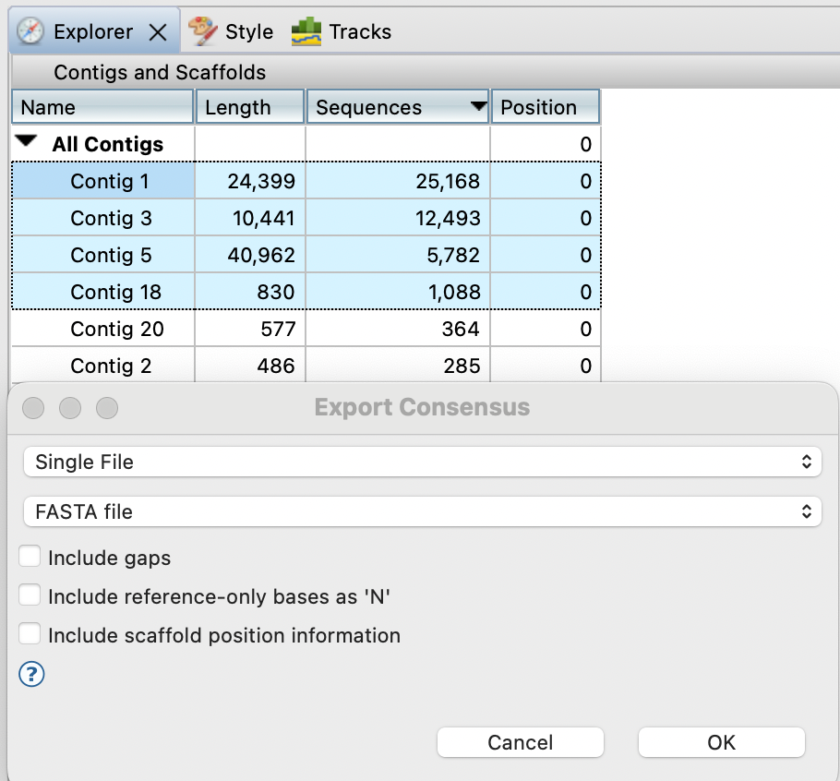
Export contigs
Select and export consensus of desired contigs as a single file in fasta format (*.fas)

Slide 25
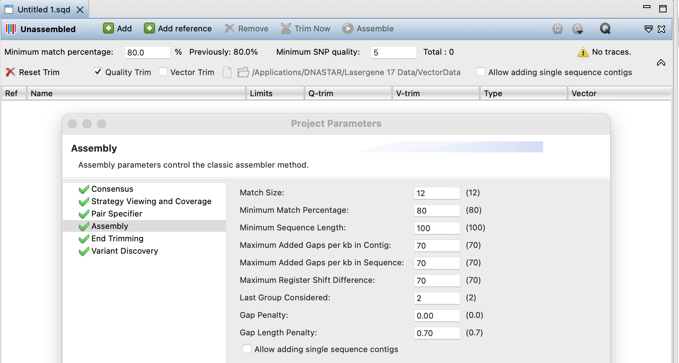
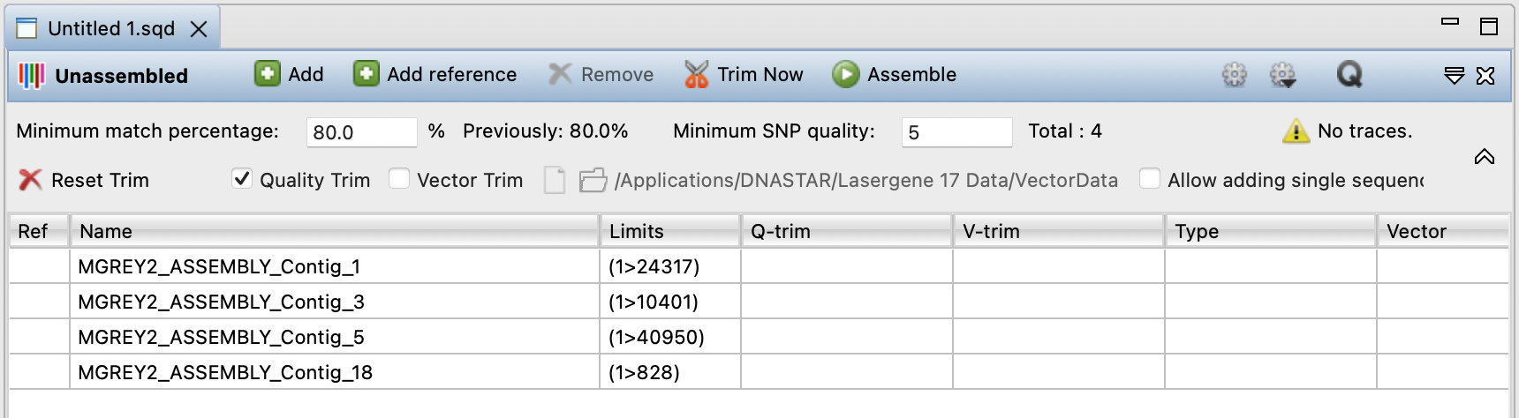
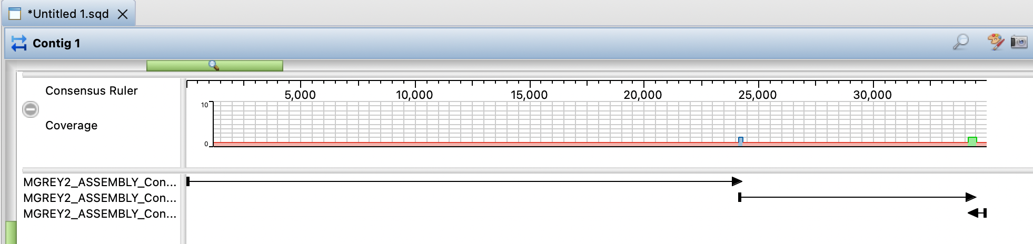
Reassembly in SeqMan Ultra
Only situation where you will want to change the default assembly parameters
Click to select

Slide 26
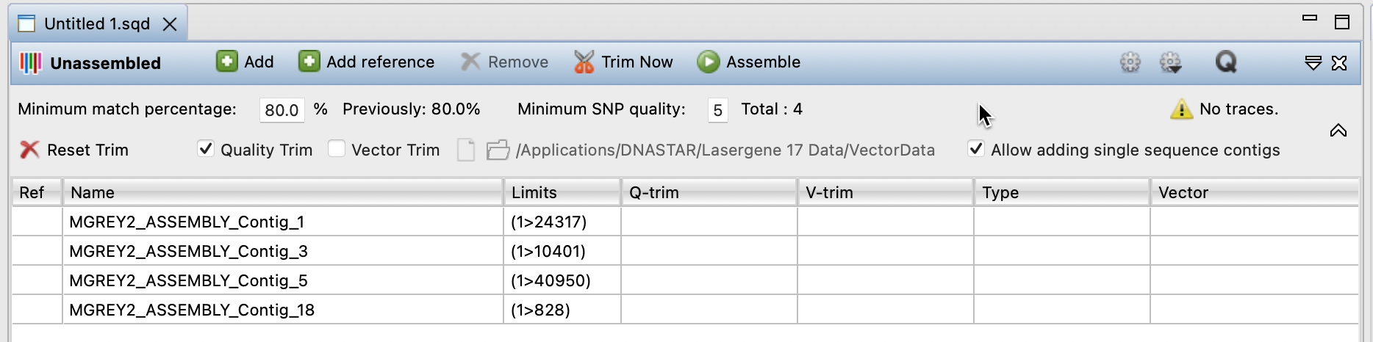
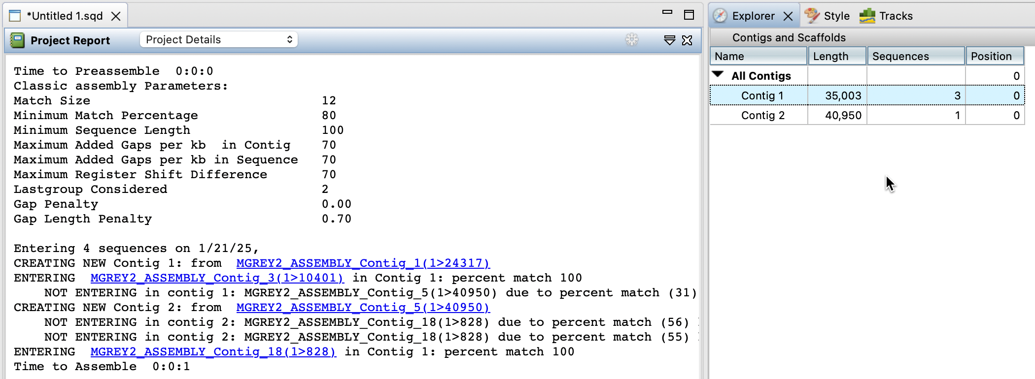
Reassembly 2

Slide 27
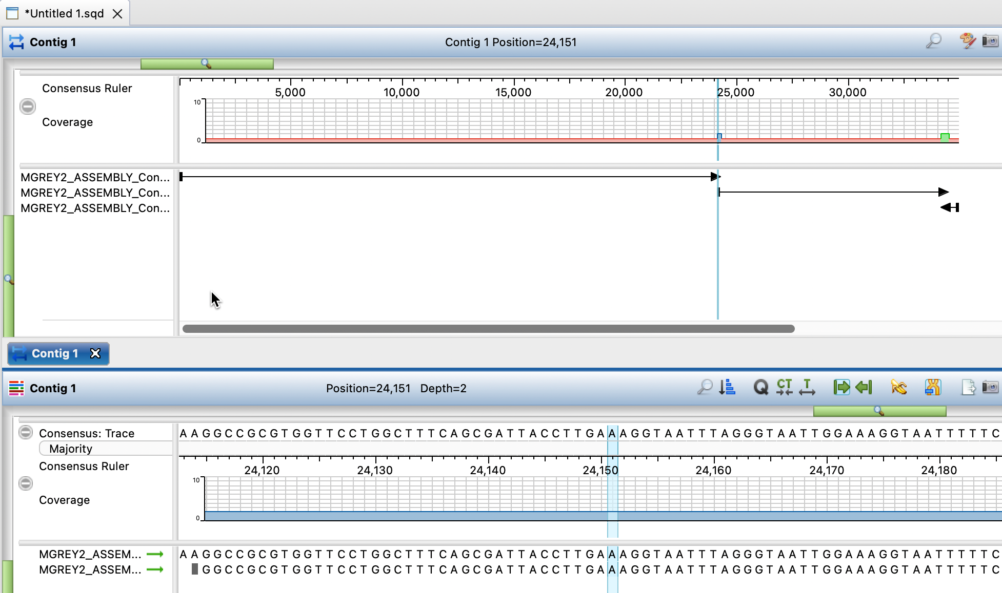
Examining alignments
Magnification bar
Alignment view
Error check

Slide 28
Genome orientation - termini

Slide 29
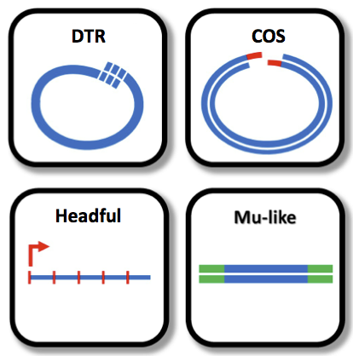
Bacteriophage Genome Termini
Phage termini are problematic
Bottom line – if your phage is related to an existing virus its genome should be colinear
If a choice exists use RefSeq/ICTV homologs
Next six slides are largely for information only
Notes:
https://research.pasteur.fr/fr/software/phageterm-determining-bacteriophage-termini-and-packaging-using-ngs-data/

Slide 30
Termini of Caudoviricetes
Cohesive (sticky) ends – 5’-extensions
(P2 and λ)
Hydrogen-bonding
Ligase
Circular molecule

Slide 31
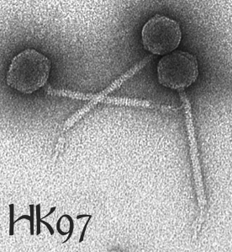
Termini of Caudoviricetes 2
B. Cohesive (sticky) ends – 3’-extensions
(HK97, D3, many mycobacteriophages)
Site-specific packaging
(http://www.pitt.edu/~duda/HK97.html)

Slide 32
Termini of Caudoviricetes 3
C. Terminal redundancy (TR; direct repeats (DR)) – Autographivirinae (T7, SP6, φKMV), T5 phage, Listeria phage A511
3’
5’
Escherichia phage T7 – 160 bp
Listeria phage A511 – 3,125 bp
Escherichia phage T5 – 10,219 bp
Bacillus phage SPO1 – 13,185 bp

Slide 33
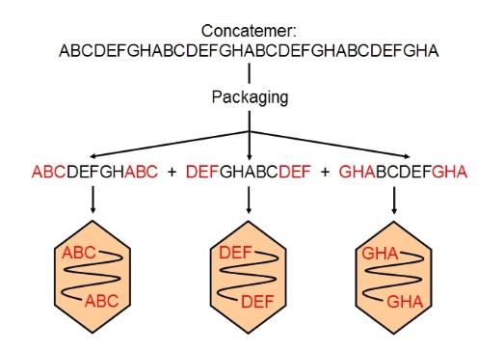
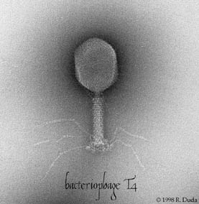
Termini of Caudoviricetes 4
D. Terminal redundancy (TR) with Circular Permutation (CP) – Escherichia phages T4 and P1
Substrate for packaging of all these phages
Headful packaging
N.B. No member of the class Caudoviricetes possess a circular genome
Notes:
(http://cronodon.com/BioTech/Virus_Tech.html http://www.asm.org/division/m/foto/T4Mic.html)

Slide 34
Termini of Caudoviricetes 5
E. Terminal proteins (TP) – a variety of phages 5’-termini
(http://www.sciencedirect.com/science/article/pii/S0042682214003742)
Notes:
phi29 DNA prepared with or without proteinase K treatment is resistant to the action of the 5'-terminal-specific exonucleases, lambda-exonuclease and T7 exonuclease. The phi29 DNA is also inaccessible to phosphorylation by polynucleotide kinase even after treatment with alkaline phosphatase. On the other hand, phi29 DNA is sensitive to exonuclease III (emoval of mononucleotides from 3´-hydroxyl termini of duplex DNA), and the 3' termini of the DNA can be labeled by incubating with alpha-[32P]ATP and terminal deoxynucleotidyl transferase (http://www.ncbi.nlm.nih.gov/pubmed/731797).

Slide 35
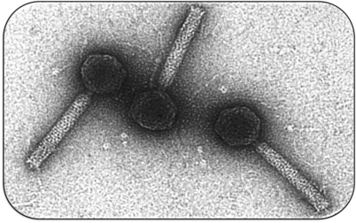
Termini of Caudoviricetes 6
F. Host DNA – coliphages Mu & D108
(http://www.sci.sdsu.edu/~smaloy/MicrobialGenetics/topics/transposons/Mu.html
http://2012.igem.org/Team:Marburg_SYNMIKRO/Project)
Notes:
In addition, B3 and many other transposable phages carry essentially random host DNA fragments on the ends of the packaged genome and have identical terminal 5′-TG dinucleotides (http://www.ncbi.nlm.nih.gov/pmc/articles/PMC516594/)

Slide 36
Some general rules on genome termini
T4-like phages begin with rIIA gene on complementary strand
Many other phages begin with TerS/L

Slide 37
Termini of Caudoviricetes
PhageTerm - Garneau JR et al. 2017. Sci Rep. 7(1):8292. doi: 10.1038/s41598-017-07910-5. PMID: 28811656.
accessible via Galaxy Pasteur (https://galaxy.pasteur.fr/)
video “How to run PhageTerm tool in Galaxy” https://www.youtube.com/watch?v=9y2gfUSLkgg
for terminal repeats you can use the magnification bar in DNASTAR

Slide 38
BREAK

Slide 39
What to do about gaps
Occasionally assembly result in two or more contigs which will not collapse into one.
Gap closure techniques:
Primer walking and Sanger sequencing – requires specialize sequencing abilities
PCR and Sanger sequencing
Splinting and reference-guided assembly

Slide 40




PCR and Sanger sequencing
Two fragments
Possibilities:
Sequence amplicon

Slide 41
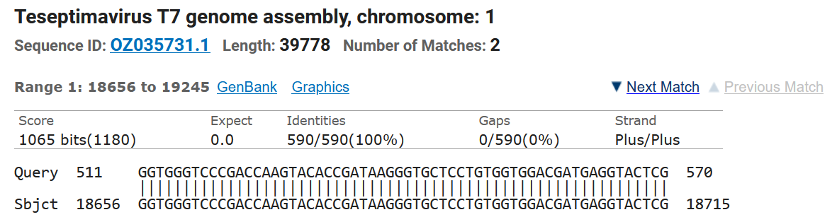

Splinting and reference-guided assembly
sequenceNNNNNsequence
(pseudogenome)
BLASTn versus Caudoviricetes (taxid: 2731619); exclude - Uncultured/environmental sample sequences

Slide 42
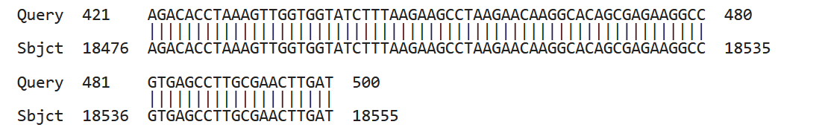
BLASTn results & splint
gap in homologous genome of 99 bp (18556-18655)
splint – homologous regions (200 bp) plus missing sequence
18356 - 18855

Slide 43
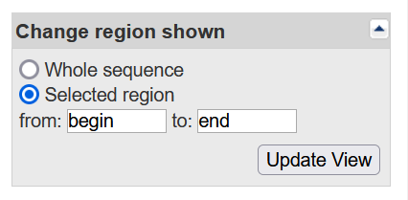
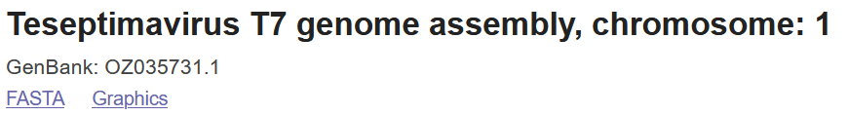
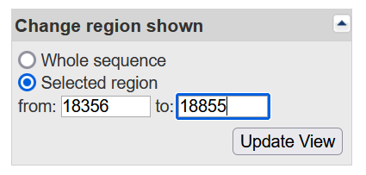
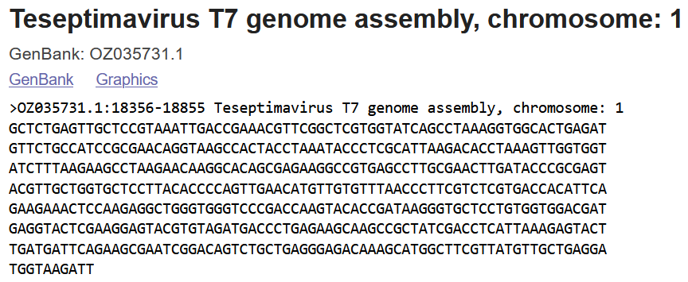
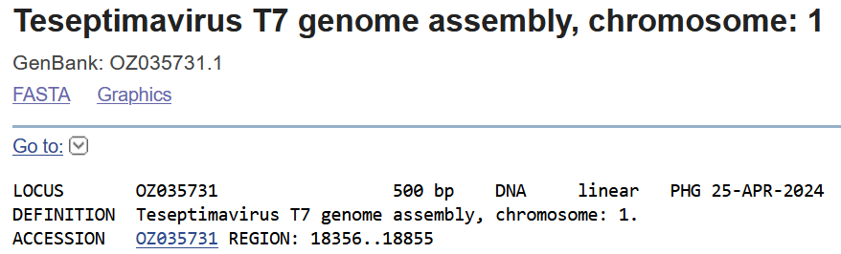
Splint

Slide 44
What next
use splint to generate a single contig
use this contig as the template in a reference-guided assembly with your Illumina sequence data.
you will be able to export the consensus for further manipulations and analyses.

Slide 45
Nonaligned contigs
what are they and should I worry?
Unaligned fragments of your phage
Host DNA
Prophage DNA
Second phage

Slide 46
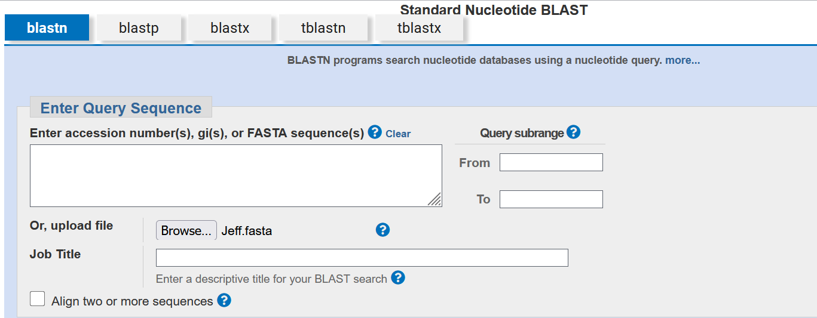
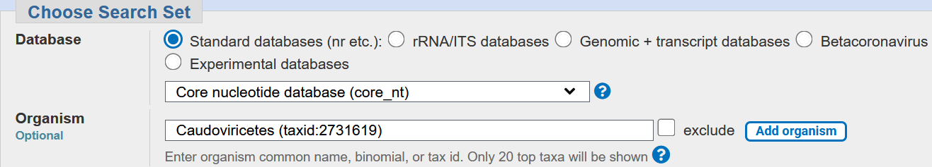
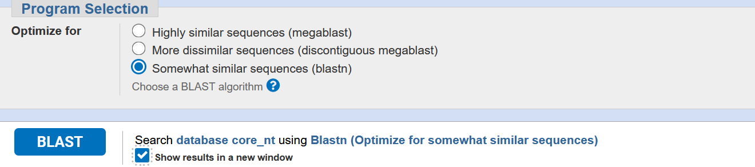
Is my phage related to anything?

Slide 47
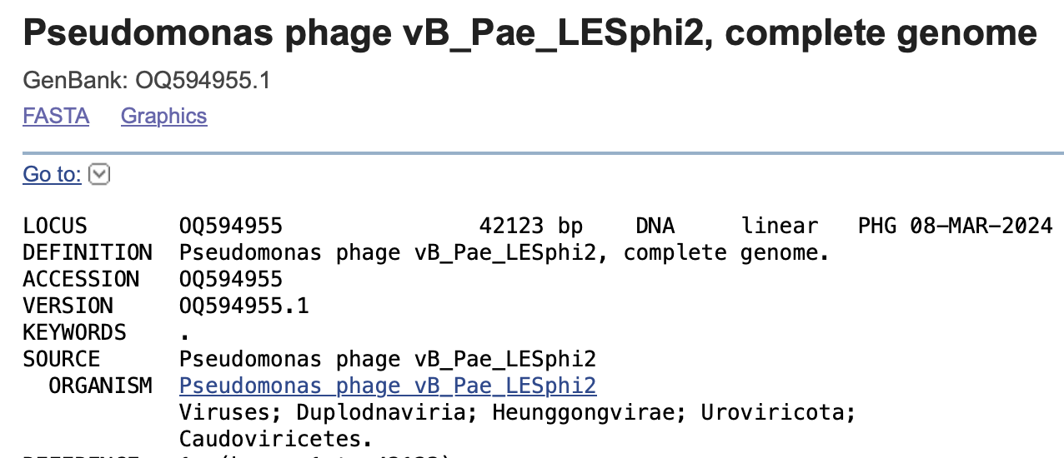
Is my phage related to anything 2?

Slide 48
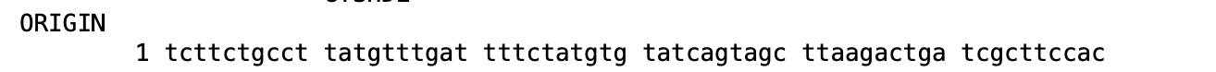
Realigning your genome 2
May require RC
May require cutting and reassembly
using SeqMan Ultra
Requires SeqBuilder Pro
Identify 5’-end of homologous phage
Cutting & reassembly will result in your phage
genome being colinear with this phage

Slide 49
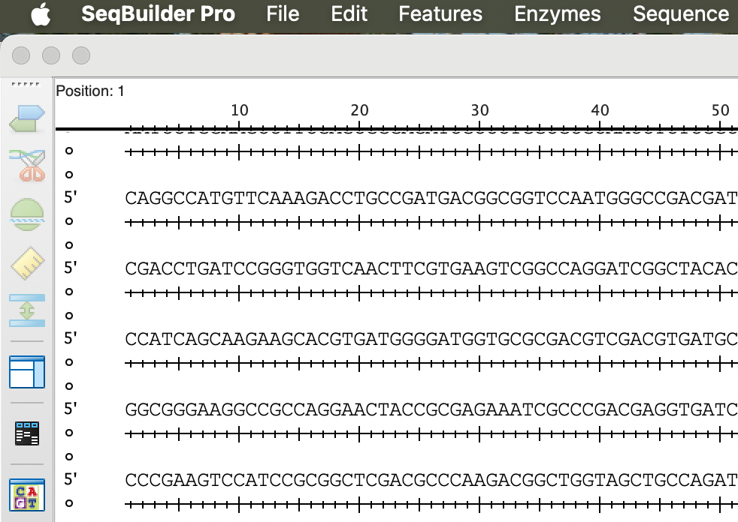
SeqBuilder Pro – Default format
Shows restriction sites automatically

Slide 50
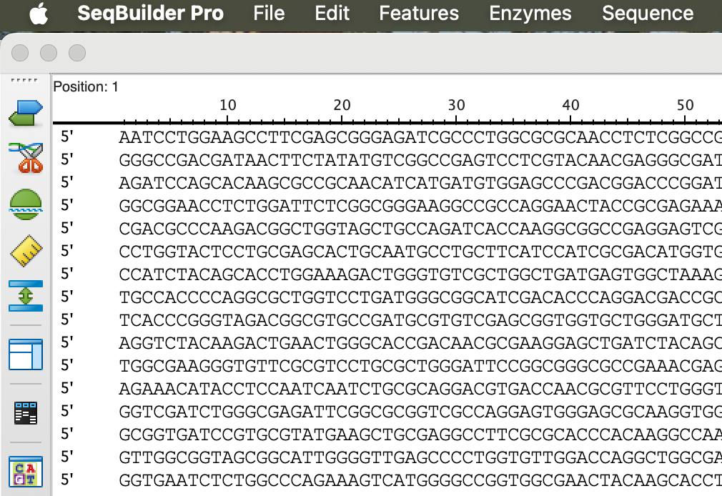

SeqBuilder Pro – EditSeq format
My preferred format

Slide 51
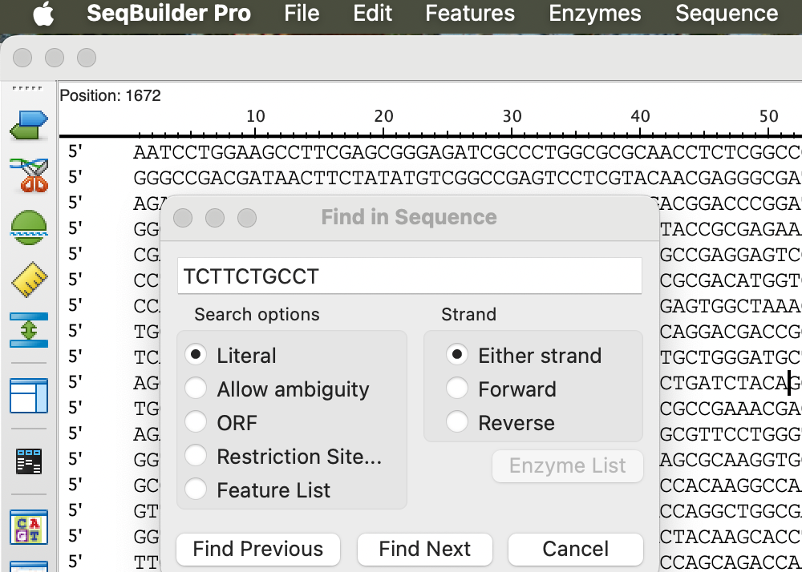
SeqBuilder Pro – Search
Identify 5’-end and cut yields two fragments which I label LEFT END and RIGHT END
Save in fasta format
Reassemble using SeqMan Ultra

Slide 52
Is sequence ready for annotation?
Questions:
Is it full length?
Is it error free?
Quick and dirty approaches:
BLASTn
BLASTx

Slide 53
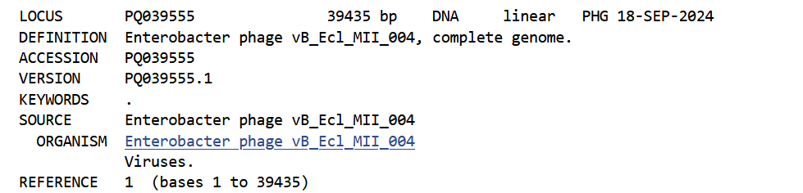
BLASTn – complete example?
BLASTn reveals it is related to Escherichia phage Peacock (MK903279; 39233 bp)
Caudoviricetes; Autographiviridae; Studiervirinae; Kayfunavirus

Slide 54
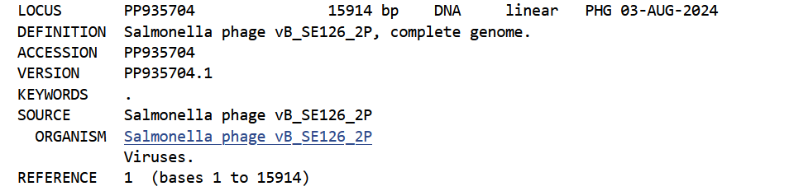

BLASTn – incomplete?
BLASTn reveals it is incomplete

Slide 55

BLASTx - frameshifts
BLASTn reveals it is related to Escherichia phage Peacock (MK903279; 39233 bp) [& complete]
BLASTx versus Escherichia phage Peacock (taxid:2591100) – huge number of frameshifts

Slide 56


What are the problems
scientists with little knowledge and experience working with phages
individuals not taking advantage of free expertise in the International Committee on Taxonomy of Viruses (ICTV)
Nanopore versus Illumina sequencing technology
Notes:
N.B. GenBank cannot exclude submissions

Slide 57

End of Part 1
Questions?

